Slide 1

Capturing the Beat of America: A Comprehensive Study of Music Genres
Amara Henry, Christina LaManna, Matthew Henry, Ifeanyi Ezugwu

Slide 2
Project description
This project aims to provide a comprehensive analysis of music genre popularity in 2022, identify the most influential artists within each popular genre during this period, and examine how certain demographics impact the distribution of music preferences.
Research questions
What are the three most popular genres of music in 2022?
What artist affected each genre the most in that year?
How does demographics affect the popularity of those genres?

Slide 3



Data sources used
STATISTA
DEVELOPER.SPOTIFY.COM
KAGGLE

Slide 4


Question #1
What are the three most popular genres of music in 2022?

Slide 5
Most popular genres

Slide 6
Most popular genres

Slide 7
Most popular genres
RANKING
#1: Other
#2: Dance/Electronica
#3: Rock/Alternative
#4: TIE: Urban & Religious
Notes:
#1: Other (acknowledging our limitations, but not removing from the top of popular genres to give credence to the fact that this categories compiles the lesser common genres but still shows that together they are beloed)

Slide 8


Question #2
What artist affected each genre the most in that year?

Slide 9
#1 Artists in genres

Slide 10


Question #3
How do demographics affect the popularity of those genres?

Slide 11
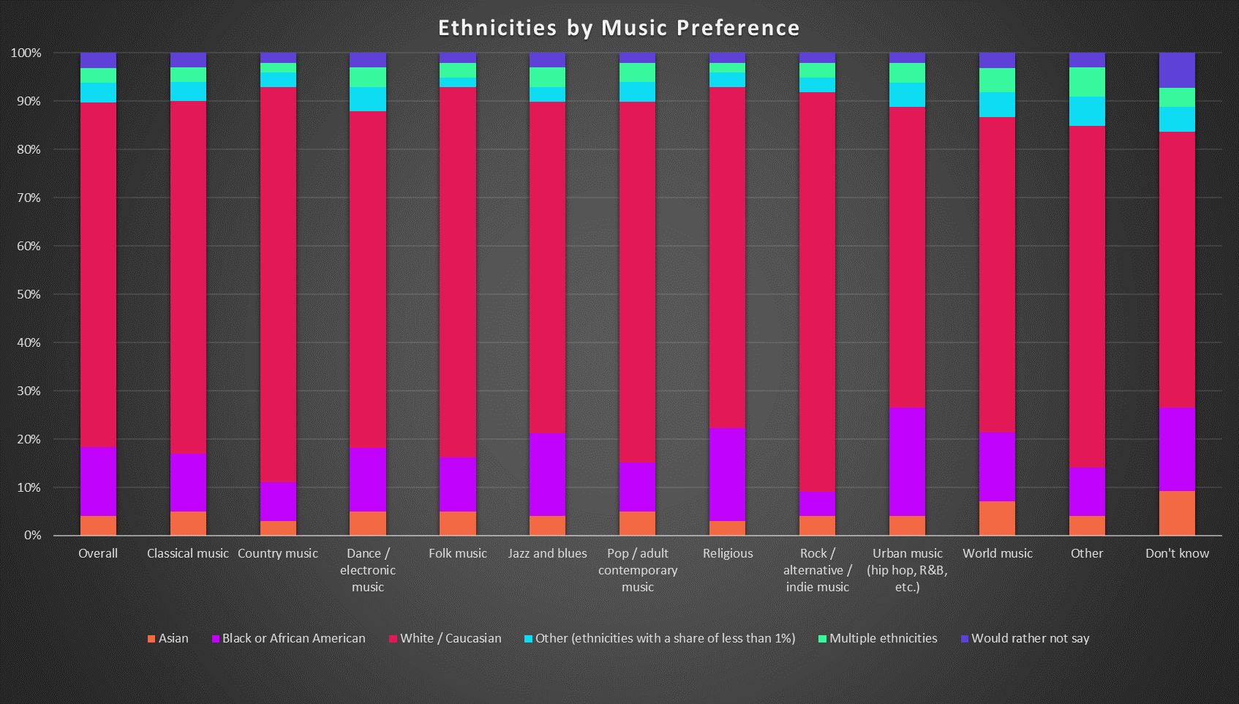
Demographics impact

Slide 12
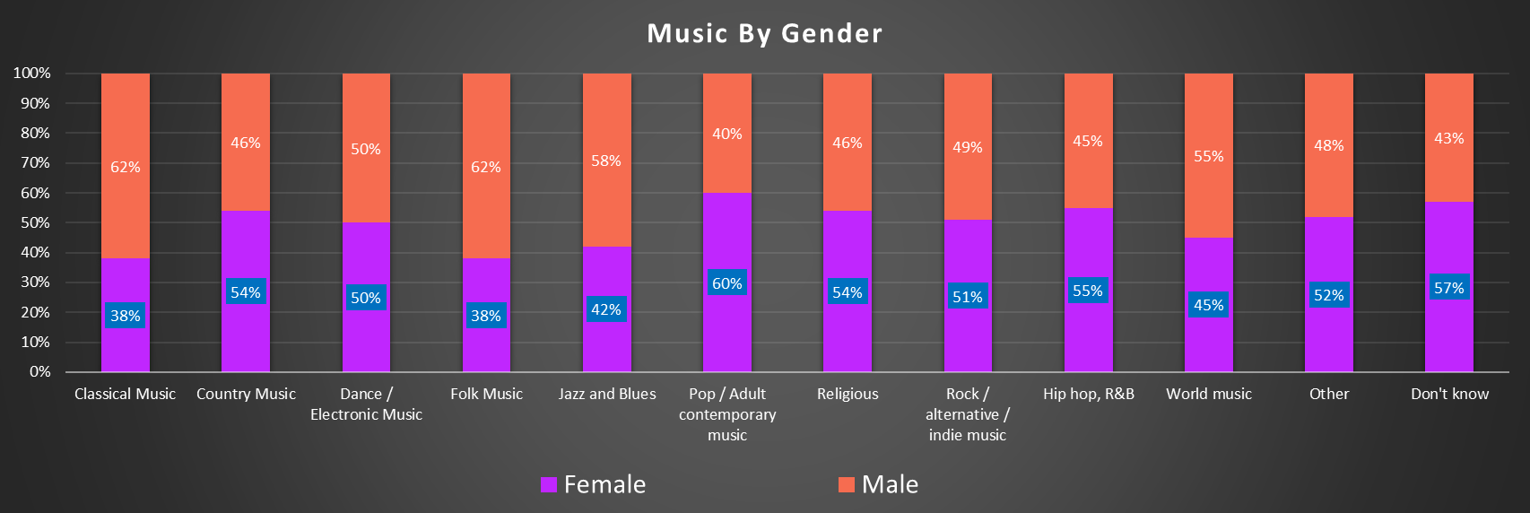
Most popular genres

Slide 13


Summary
Top Genres in US in 2022:
#1: Dance/Electronica
#2: Rock/Alternative
#3: TIE: (HipHop/R&B/Rap) & Religious

Slide 14

Thank you
GITHUB:
https://github.com/cnlamanna/Project-1

